Slide 1


CSP South Central Associates & Support Workers online Conference & CPD
Welcome
Notes:
Introductory slide
Thanks to SEC network for opportunity to speak
What I hope you will get out of the day
Managers:
To recognise the CSP's commitment to the development of Support Workers; the benefits of support workers having CSP membership and being released for CSP led events
Associates:
To feel that as CSP Members they can count on our support, and even more support going forwards; the CSP is fighting their corner; the CSP and its members recognise the value of Associates & SWs; it is worth continuing their membership as exciting developments are ahead
Non Member Support Workers:
To feel they really need to join the CSP otherwise they will miss out!; they will feel inspired to be part of a community with the CSP at the forefront of national physiotherapy development; the CSP is there to support them and recognises their value; they can feel proud to be a member of the CSP

Slide 2
Housekeeping
Microphones to mute
Use the chat room to introduce yourself and also pose questions
This event is being recorded and will be shared on the South Central web page after the event and emailed to you via Eventbrite. It is also being streamed live via the CSP South Central Facebook group so that you can play it back later https://www.facebook.com/groups/590057697797178/
Non CSP Members please confirm you are happy to receive emails from us after the event by messaging Mindy dallowaym@csp.org.uk (full details on joining the CSP will feature in tonight’s presentation and shared in the chat room)
An anonymised transcript of the chat room will be shared on the South Central web page
Feel free to tweet #SupportWorkersMatter and @cspsouthcentral

Slide 3



CSP resources
How are you valued?
Your value during the pandemic
Student education what’s stopping you?
Valuing You
Why I don’t always feel valued?
Clinical CPD
CSP membership
Opportunity knocks
Notes:
Aim of this keynote is to share with you the CSP position on the direction of travel for our profession and our workforce
Explicitly share where support workers feature in this
The UK physiotherapy profession needs to grow, develop and lead change for the health and care system to meet future population and patient needs in effective, sustainable ways.
Population ageing, working longer, more of us living with multiple long term conditions – huge demand on the profession but also an opportunity
This needs more of us (might want to mention increase in student training places in England)
This is not more of us doing the same – it is more of us working differently
In particular – as expert advisors; as public health champions; as first contact practitioners and as advanced practitioners; as leaders of health and care services; as leaders in supporting patients to self-manage; as practitioners whose practice is enabled by technology and as an evolving agile and versatile solution to contemporary health and care challenges
This is not a story about the growth and development of the registered workforce. It’s about the growth and development of the entire workforce
Support workers play a significant part in the provision of safe, high quality physiotherapy care. We see, in the future, they will play an even bigger part and their roles will be even more crucial, we simply cannot realise the ambitions for the profession without them

Slide 4
Lack of impact data
Limited formal development pathways
Assumptions and beliefs
Disparities and inaccuracies
Uncertainty and inaction
Innovative and brave
Limited development and progression opportunities
Notes:
Aim of this keynote is to share with you the CSP position on the direction of travel for our profession and our workforce
Explicitly share where support workers feature in this
The UK physiotherapy profession needs to grow, develop and lead change for the health and care system to meet future population and patient needs in effective, sustainable ways.
Population ageing, working longer, more of us living with multiple long term conditions – huge demand on the profession but also an opportunity
This needs more of us (might want to mention increase in student training places in England)
This is not more of us doing the same – it is more of us working differently
In particular – as expert advisors; as public health champions; as first contact practitioners and as advanced practitioners; as leaders of health and care services; as leaders in supporting patients to self-manage; as practitioners whose practice is enabled by technology and as an evolving agile and versatile solution to contemporary health and care challenges
This is not a story about the growth and development of the registered workforce. It’s about the growth and development of the entire workforce
Support workers play a significant part in the provision of safe, high quality physiotherapy care. We see, in the future, they will play an even bigger part and their roles will be even more crucial, we simply cannot realise the ambitions for the profession without them

Slide 5
The contribution of the support workforce:
CSP position
Demand and ambitions direct that we need to optimise the contribution of SWs. Workforce development as a continuum
Growth is needed – in line with registered workforce growth and other professions’ support workforces (nursing 35% of total workforce)
Capability optimised to work at top of scope, greater delegation to release registered capacity – not substitution
Increase in higher level roles with consistent governance arrangements
Increase contribution to practice based learning
Notes:
Aim of this keynote is to share with you the CSP position on the direction of travel for our profession and our workforce
Explicitly share where support workers feature in this
The UK physiotherapy profession needs to grow, develop and lead change for the health and care system to meet future population and patient needs in effective, sustainable ways.
Population ageing, working longer, more of us living with multiple long term conditions – huge demand on the profession but also an opportunity
This needs more of us (might want to mention increase in student training places in England)
This is not more of us doing the same – it is more of us working differently
In particular – as expert advisors; as public health champions; as first contact practitioners and as advanced practitioners; as leaders of health and care services; as leaders in supporting patients to self-manage; as practitioners whose practice is enabled by technology and as an evolving agile and versatile solution to contemporary health and care challenges
This is not a story about the growth and development of the registered workforce. It’s about the growth and development of the entire workforce
Support workers play a significant part in the provision of safe, high quality physiotherapy care. We see, in the future, they will play an even bigger part and their roles will be even more crucial, we simply cannot realise the ambitions for the profession without them

Slide 6



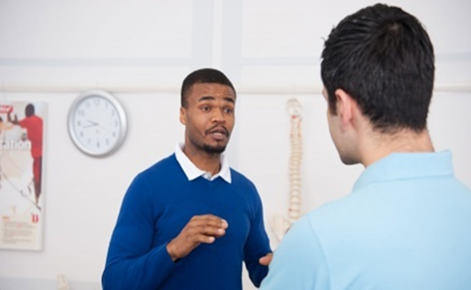

CSP Resources
Associate Hub
https://www.csp.org.uk/networks/associates-support-workers
Notes:
Aim of this keynote is to share with you the CSP position on the direction of travel for our profession and our workforce
Explicitly share where support workers feature in this
The UK physiotherapy profession needs to grow, develop and lead change for the health and care system to meet future population and patient needs in effective, sustainable ways.
Population ageing, working longer, more of us living with multiple long term conditions – huge demand on the profession but also an opportunity
This needs more of us (might want to mention increase in student training places in England)
This is not more of us doing the same – it is more of us working differently
In particular – as expert advisors; as public health champions; as first contact practitioners and as advanced practitioners; as leaders of health and care services; as leaders in supporting patients to self-manage; as practitioners whose practice is enabled by technology and as an evolving agile and versatile solution to contemporary health and care challenges
This is not a story about the growth and development of the registered workforce. It’s about the growth and development of the entire workforce
Support workers play a significant part in the provision of safe, high quality physiotherapy care. We see, in the future, they will play an even bigger part and their roles will be even more crucial, we simply cannot realise the ambitions for the profession without them

Slide 7
Covid-19: Deconditioning and beyond
By Chris Tuckett,
Physiotherapist and
Physical Activity
Clinical Champion
@HealthPhysio

Slide 8
What we’ll cover
Where are we now
Covid-19, lockdown and physical activity
Covid-19, deconditioning and the recovery of inpatients
Covid-19, when exercise may not be the answer
@HealthPhysio

Slide 9
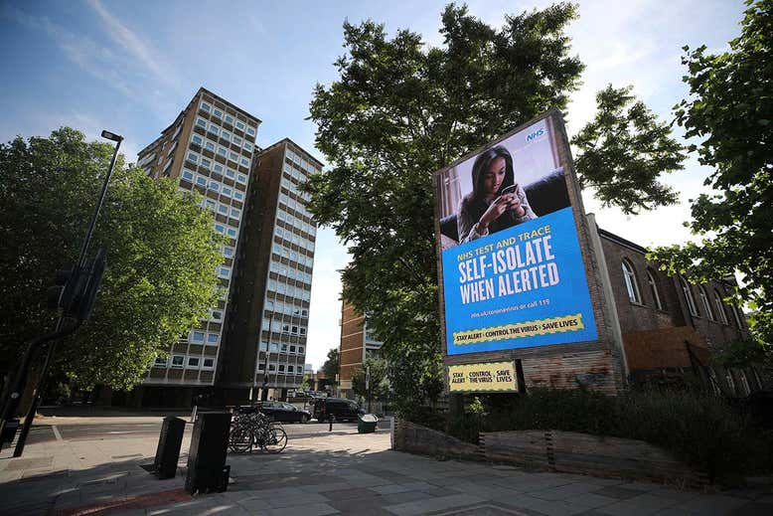
Where are we now?
COVID-19!
@HealthPhysio
Notes:
1- New Scientist 17 June 2020 https://www.newscientist.com/article/mg24632873-000-how-many-of-us-are-likely-to-have-caught-the-coronavirus-so-far/
2- Vaccine estimated to be available mid 2021 at earliest
3- ‘Your Covid Recovery’ will be up and running by end of July.
4- Societal change- shopping, work and leisure time

Slide 10
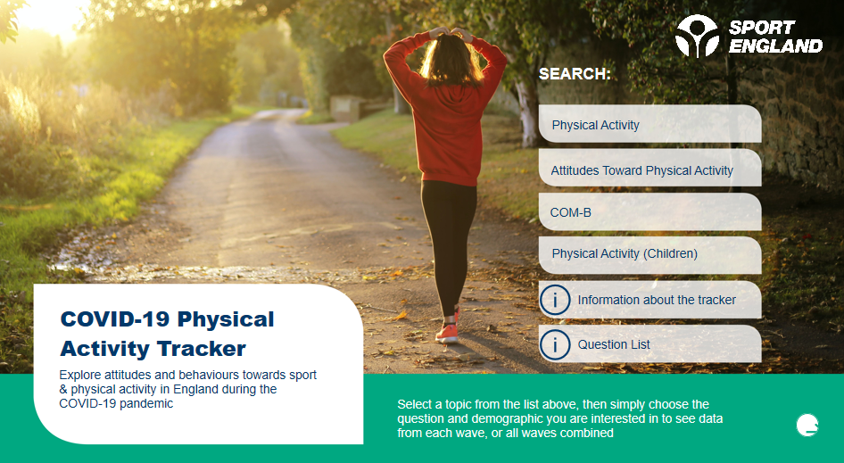
Covid-19, lockdown & physical activity
Notes:
Sport England commissioned Savanta ComRes to conduct regular surveys. Each week for the initial eight weeks of lockdown, they surveyed the English public to assess their activity levels and attitudes towards physical activity.
Throughout this period, SE published the results to help people understand the impact of coronavirus and how they could help to keep the nation active.

Slide 11
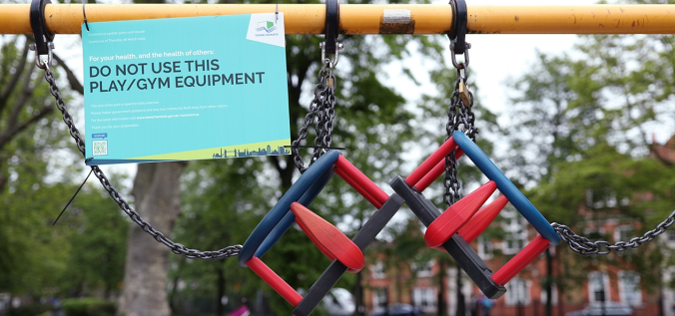
Covid-19, lockdown & physical activity
33% doing 30+ mins PA on 5 or more days a week
BUT……familiar inequalities still exist or worsened!
Notes:
31% of adults did more PA, 41% did less PA
In children 30% did more and 38% did less

Slide 12

Covid-19, lockdown & physical activity
57% surge in sales of bicycles
£2billion active travel fund *5
“double cycling and increase walking by 2025”
"There is no situation, there is no age and no condition where exercise is not a good thing” *6
Notes:
*5 - Active travel fund https://www.gov.uk/government/news/2-billion-package-to-create-new-era-for-cycling-and-walking
*6- CMO Quote https://www.leisureopportunities.co.uk/news/Chief-Medical-Adviser-Chris-Whitty:-exercise-the-best-thing-you-can-do-during-lockdown/345304 speaking on 15th April 2020 during Daily Briefing.

Slide 13
Covid-19, lockdown & physical activity
62% think it’s important to be active during the pandemic
69% do PA for their physical health
65% for their mental health
Males significantly more active (36%) than women (28%)
@HealthPhysio
Notes:
Week 4 - Males/women page 22 of SE report

Slide 14
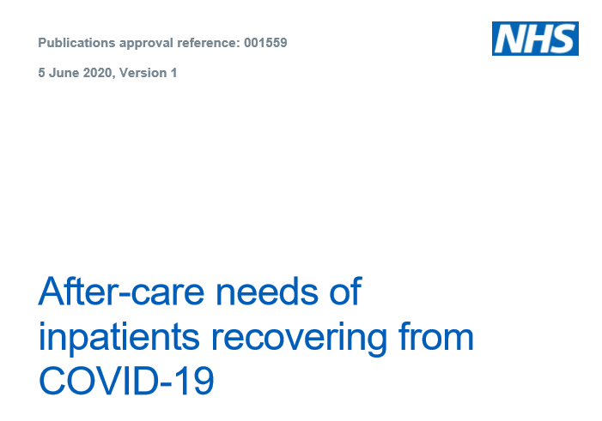
Covid-19, deconditioning & inpatient recovery
NHS England & Improvement document (June 5th) *7
95,000 COVID positive patients cared for & D/C
Rapidly evolving knowledge base, inequalities persist
Physical, psychological and social deconditioning
Notes:
*7- https://www.england.nhs.uk/coronavirus/wp-content/uploads/sites/52/2020/06/C0388-after-care-needs-of-inpatients-recovering-from-covid-19-5-june-2020-1.pdf

Slide 15
Covid-19, deconditioning & inpatient recovery
PICS (present in 56% of patients at 12 months following prolonged ventilation)
Respiratory and Pulmonary rehab support
Dysphagia (Nutrition)
Cardiology
Hospital-acquired muscle weakness (and/or ICU-AW)
Notes:
*7- https://www.england.nhs.uk/coronavirus/wp-content/uploads/sites/52/2020/06/C0388-after-care-needs-of-inpatients-recovering-from-covid-19-5-june-2020-1.pdf
PICS= Post intensive care syndrome
Only 15% of discharge communications included information on nutrition. 70% of those diagnosed with C19 are either overweight or obese.
Acute myocardial injury prevalent in 12% of D/C survivors (52% in those that died)
Incidence of intensive care acquired weakness (ICU-AW) is recorded as between 25% and 50% in a general critical care population. ICU-AW is associated with rapid early muscle mass loss (up to 20%).
Even ‘normal’ hospital acquired deconditioning is worsened in presence of COVID-19.
Benefits of early physical rehabilitation following ICU discharge (mostly home-based and/or solely exercise training) on quality of life and mortality are variable (mainly due to heterogeneity of population). However, exercise capacity and quality of life improved significantly following an eight-week pulmonary rehabilitation programme in survivors of ARDS due to severe influenza A (H1N1) pneumonitis.

Slide 16
Covid-19, deconditioning & inpatient recovery
Start PA from admission
Recovery will be slow
Multi-disciplinary / service
Social Care involvement critical
Greater involvement of tech and innovation
BUT be wary of evolving knowledge base- FATIGUE

Slide 17

Covid-19, when exercise may not be the answer
=> Post-Viral Fatigue (PVF)
=> PVF syndrome (PVFS)
=> ME/CFS
Not due to deconditioning
Notes:
The clinical picture is that patients who have had COVID-19 are reporting extreme fatigue beyond the usual reported levels NHS document.
Some degree of post-viral fatigue (PVF) or debility is a fairly common occurrence after any type of viral infection.
Additional symptoms may also develop, where the term post viral fatigue syndrome (PVFS) may be a more appropriate diagnosis.
Fatigue and lack of energy are turning out to be a characteristic symptom of C19.

Slide 18
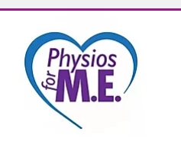
Covid-19, when exercise may not be the answer
Management of PVF and PVFS:
Rest!
Symptom contingent pacing
Conserve energy
Nutrition and sleep
Standard rehab can be detrimental
Notes:
Physios for ME- https://www.physiosforme.com/covid-19 listen to podcast

Slide 19
Summary
Lockdown has exaggerated previous PA habits
COVID-19 exaggerates potential for deconditioning
Standard rehab model may not apply - THINK PVF!
Support workers are the ultimate patient advocate- speak up!

Slide 20
Thank you
@HealthPhysio
Notes:
Above can be part of a PVFs and also hint at possible ME/CFS- there is no hard distinction between the conditions- but an alert professional will be constantly monitoring response to interventions.
Physios for ME- https://www.physiosforme.com/covid-19 listen to podcast

Slide 21
Rob Minter
Physiotherapy Assistant,
CSP Associate Member,
Support worker reference group representative.
Foundation Degree (FdSc) Level 5 Professional Practice in Health and Social Care Apprenticeship.
robert.minter@hey.nhs.uk
robert.minter@nhs.net

Slide 22
Why FdSc?
Opportunity
To increase my own knowledge.
To push myself.
Physiotherapy Degree.

Slide 23
Support and Learning.
20% workload.
Time management
Library
Year 1 - 5 Modules
Year 2 - 4 Modules

Slide 24
Post FdSc
Student Inductions.
Contacting the CSP/Claire.
Ankylosing Spondylitis – Ax, BASMI, & Rx.
Isokinetics.
December 2019 London.
Joined the support workers reference group.
Rheumatology telephone triage.

Slide 25
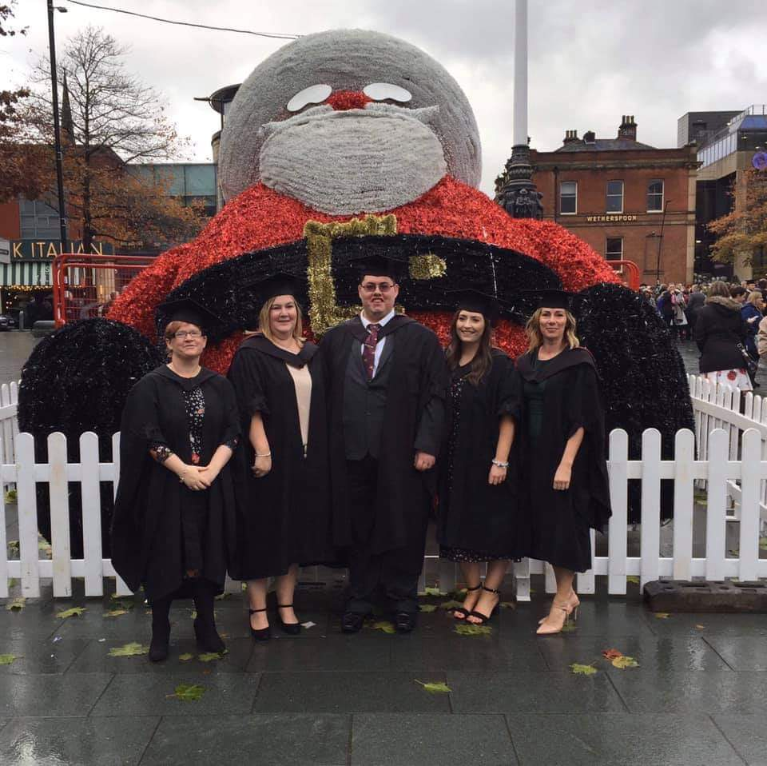

Slide 26
Rob Minter
Physiotherapy Assistant,
CSP Associate Member,
Support worker reference group representative.
Foundation Degree (FdSc) Level 5 Professional Practice in Health and Social Care Apprenticeship.
robert.minter@hey.nhs.uk
robert.minter@nhs.net

Slide 27


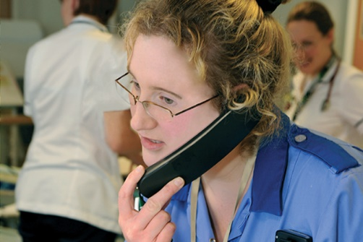
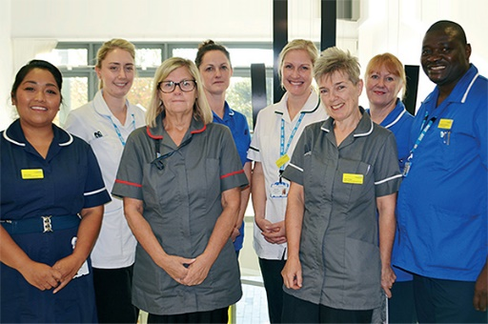
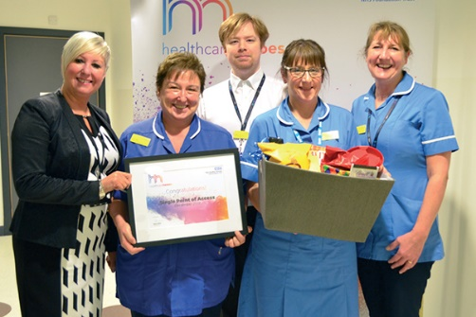
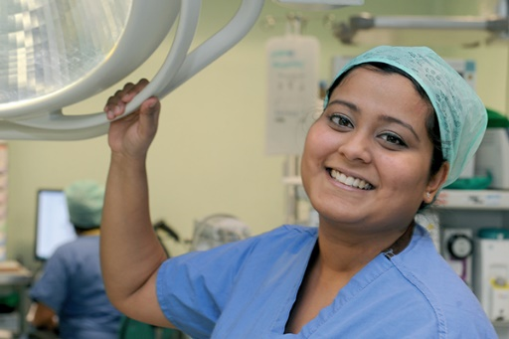
Introduction of Lead AHP support worker role
Karen Lewis Deputy Chief AHP Dudley Group NHS Foundation Trust

Slide 28
The Motivation
Obvious and experienced skillset and potential of support workers.
Workforce challenges across qualified professions
People plan and NHS Long term plan
Opportunities for increased efficiency
Enriched roles and #joy in work

Slide 29
The Journey
Engagement with support workers in Therapy services.
Inspiring characters and trail blazers.
Discussion with Chief people officer and organisational development lead – link to workforce strategy.
National support from professional bodies
Appetite to explore unchartered territory and “think outside the box”
Secondment agreed!

Slide 30
The role
Engage with support workers within the organisation as a peer to listen to their views, experiences and aspirations of our people.
Identify talent and ambition within the support worker workforce, not necessarily with a view to progressing to apprenticeships or qualified roles, but to be supported, encouraged and enabled to develop and progress.
Identify opportunities for sharing of the good practice and leadership that already exists across the organisation.
Identify and lead potential work streams to optimise the contribution of support workers.
Act as ambassadors to promote and celebrate successes both locally and nationally.

Slide 31
The expected outcomes
Patients
Workforce
Organisation
Notes:
Patients – it is people in supporting roles that have the most direct patient care. By safely extending the skill set and scope of our support workers, more care could be delivered by fewer people reducing duplication and supporting continuity of care and effective communication. Patients experience and outcomes would be enhanced and be reflected in feedback.
Workforce – our support worker workforce would feel listened to and valued and would receive targeted investment to extend their contribution to patients care. This in turn would translate into improved morale and support a career development framework impacting on positive retention and recruitment. Time would be realised for qualified staff members to be able to concentrate their efforts on activities appropriate to band and role reducing stress and enhancing team working.
Organisational – our staff will feel proud to work for DGFT and see the Trust as a place where they are valued and respected and want to work and stay. This will be evidenced in improvements in pulse surveys and the annual staff survey. Through improvement in engagement and transformation, organisational efficiency will be enhanced impacting on quality, safety, performance and finance. The Trust will develop a reputation as promoting a culture of compassionate and inclusive leadership at all levels which supports innovation and a commitment to lifelong learning for all.

Slide 32
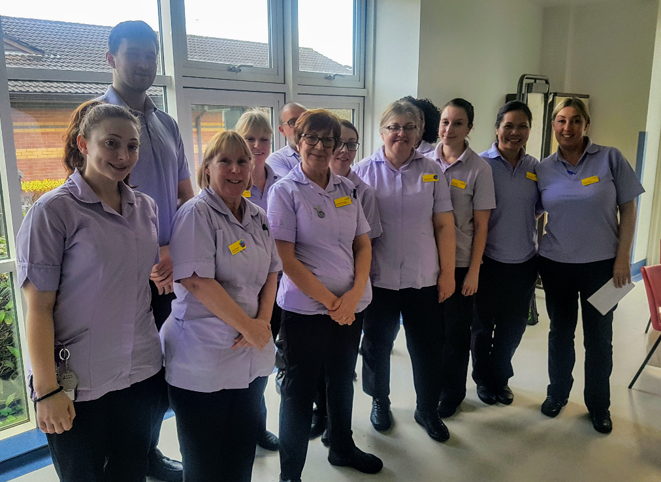
You are all amazing!
karen.lewis36@nhs.net
Twitter: @KarenLe08016942

Slide 33
Your role in student placement education
What do you think students on placement can learn form support workers?
What do you think are the barriers and challenges to support workers being more formally involved in the education of students on placement?
What could the CSP do to help
Notes:
Aim of this keynote is to share with you the CSP position on the direction of travel for our profession and our workforce
Explicitly share where support workers feature in this
The UK physiotherapy profession needs to grow, develop and lead change for the health and care system to meet future population and patient needs in effective, sustainable ways.
Population ageing, working longer, more of us living with multiple long term conditions – huge demand on the profession but also an opportunity
This needs more of us (might want to mention increase in student training places in England)
This is not more of us doing the same – it is more of us working differently
In particular – as expert advisors; as public health champions; as first contact practitioners and as advanced practitioners; as leaders of health and care services; as leaders in supporting patients to self-manage; as practitioners whose practice is enabled by technology and as an evolving agile and versatile solution to contemporary health and care challenges
This is not a story about the growth and development of the registered workforce. It’s about the growth and development of the entire workforce
Support workers play a significant part in the provision of safe, high quality physiotherapy care. We see, in the future, they will play an even bigger part and their roles will be even more crucial, we simply cannot realise the ambitions for the profession without them

Slide 34


Video
CSP associate membership - what does it offer

Slide 35
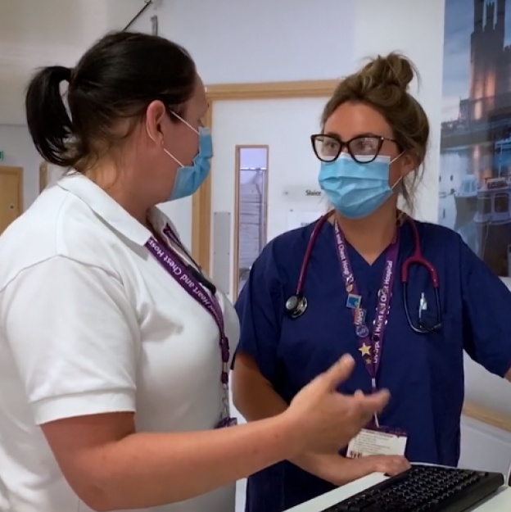
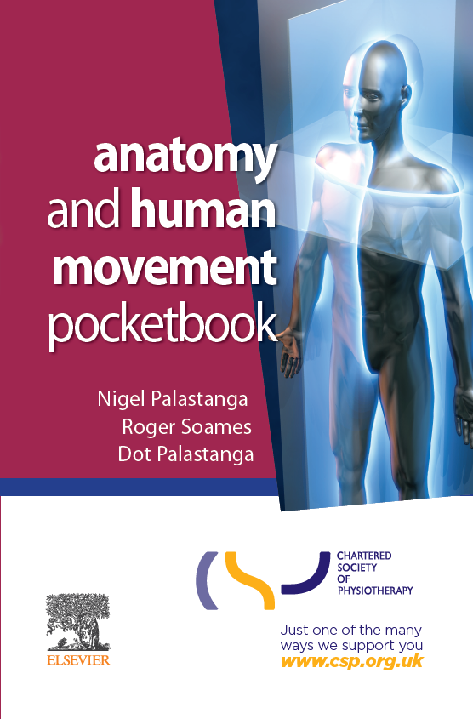

BECOME AN ASSOCIATE MEMBER TODAY
Join at www.csp.org.uk/associate
Complete your online application by midnight on 27th September to be eligible for a FREE pocketbook
To claim your gift, email Asha
(israma@csp.org.uk) with
your full name
application ID (on completion)
preferred choice of pocketbook
£9.64 per month
Each worth
over £22

